Slide 1


Community Health Needs Assessment
Responding to Community Needs
Sanilac County
March 2025

Slide 2
CHNA Process
1. Community Input
2. Health Indicator Data
3. Identify Priorities
4. Compare to 2021 Plan
5. Assess Resources
6. Determine actions

Slide 3




CHNA Step | Status/Timeline
Collect Community Input | Regional Survey administered in fall 2024. Zip code report created with comparison upon request.
Review Health Indicator Data & Community Input Survey Results | Monthly 1
Identify and Prioritize Community Health Needs | Month 2
Write Report | Month 3-4
Implementation Plan | Monthly 5-6
Resource Assessment of Existing Services and Community Services for all needs | Month 5
Identification of gaps and strategies to address gaps. | Month 6
Writing of the Implementation Plan | Month 6

Slide 4
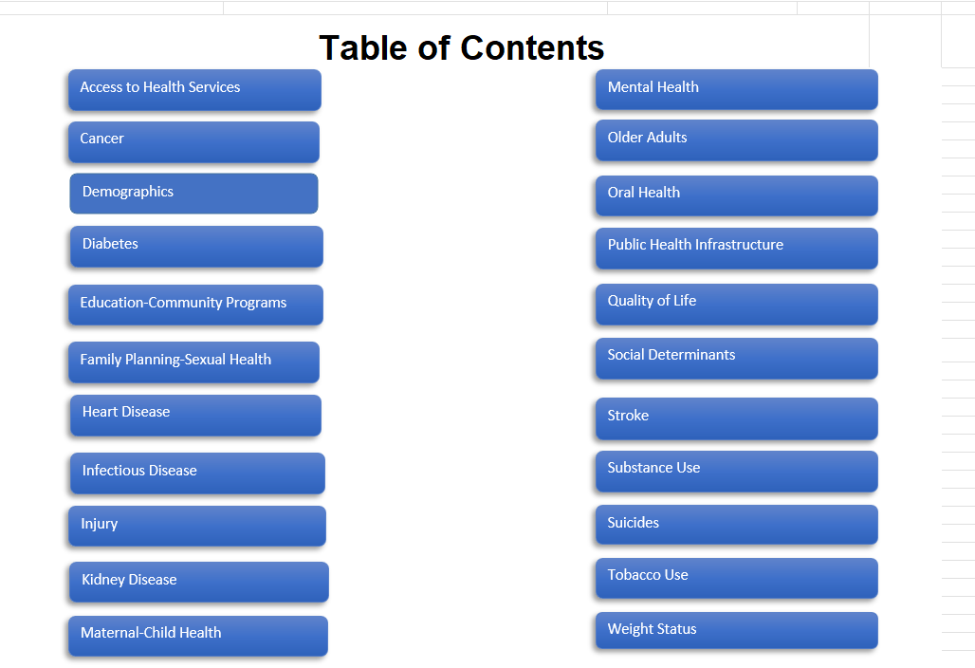
Review of Health Indicators
Data Chartbook
Compiled quantitative data for all four counties in alignment with priorities identified in Rural Healthy People 2030.
Compared trend data across the four counties and to Michigan averages.

Slide 5
Key Data Sources
Michigan Department of Health and Human Services- https://vitalstats.michigan.gov/osr/Index.asp
Michigan Behavioral Risk Factor Survey- http://www.michigan.gov/mdhhs/0,5885,7-339-71550_5104_5279_39424-134707--,00.html
Michigan Profile for Healthy Youth- https://mdoe.state.mi.us/schoolhealthsurveys/ExternalReports/CountyReportGeneration.aspx
County Health Rankings- www.countyhealthrankings.org
United States Census- https://data.census.gov/table
Great Start Data Set- Available from Local Great Start Collaborative and compiled by the Michigan League for Public Policy
Note: all charts are taken from the Data Chartbook which has links to source data. This presentation will also become outdated, so we encourage you to seek the more current data in the Data Chartbook by emailing braun@thumbhealth.org
This report was supported in part by the Health Resources and Services Administration (HRSA) of the U.S. Department of Health and Human Services (HHS) as part of an award to the Sanilac County Community Foundation on behalf of a four year cross-sector partnership grant totaling $1,200,000 with 0% percentage financed with nongovernmental sources. The contents are those of the author(s) and do not necessarily represent the official views of, nor an endorsement by, HRSA, HHS or the U.S. Government.

Slide 6
Health Indicators
Infants and Children
Adolescents
Adults
Older Adults
Across the Life Cycle

Slide 7

Thinking about the needs that overlap all four counties and county trends and comparisons, what issues rise to the top for your organization? Are there missing issues?
NOTES Page provided by your presenter.
What stands out to you as positive indicators? | What stands out to you as a concern or negative indicator?
Thinking about the needs that overlap all four counties and county trends and comparisons, what issues rise to the top for your organization? | Are there missing issues?

Slide 8
The Target Population
Demographics
Social Determinants of Health
Quality of Life

Slide 9
Sanilac County
Highest in Region for % of Children Second Highest % Rural Second Highest in Region for % of Seniors Highest % below age 18
Demographics | Michigan | Huron | Lapeer | Sanilac | Tuscola
Population | 10,051,595 | 31,258 | 88, 703 | 40,574 | 53,071
% below 18 years of age | 21.4% | 19.2% | 20.1% | 21.2% | 20.3%
% 65 and older | 18.2% | 26.6% | 19.5% | 22.6% | 21.5%
% Non-Hispanic African American alone | 13.2% | 0.4% | 1.1% | 0.4% | 1.0%
% Native American & Alaska Native alone | 0.3% | 0.2% | 0.1% | 0.1% | 0.3%
% Asian alone | 3.3% | 0.6% | 0.3% | 0.2% | 0.4%
% Hispanic | 5.7% | 2.7% | 5.0% | 4.2% | 3.6%
% Non-Hispanic white alone | 73% | 93.6% | 90.2% | 92.4% | 92.0%
% Rural | 26.5% | 100% | 85.9% | 93.6% | 89.9%
Data 2023 for Census and 2024 County Health Rankings Report
https://data.census.gov/table
www.countyhealthrankings.org

Slide 10
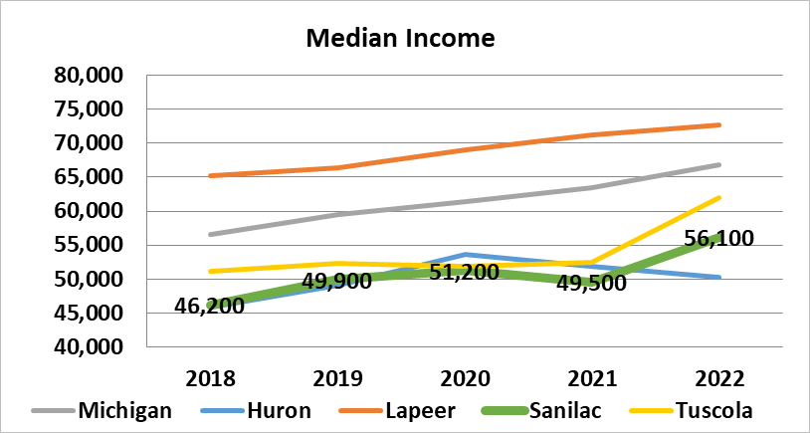
Median Household Income
 | 2022
Michigan | $66,900
Huron | $50,200
Lapeer | $72,700
Sanilac | $56,100
Tuscola | $62,000
County Health Rankings 2024
www.countyhealthrankings.org

Slide 11
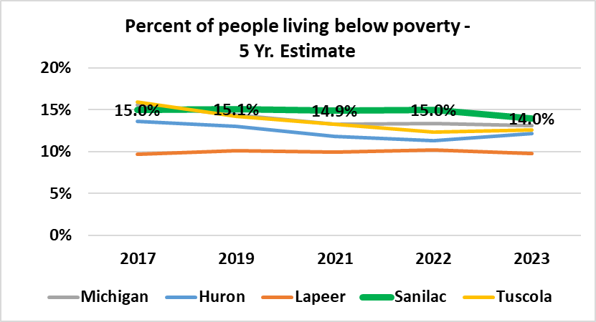
Percent of people living below poverty - 5 Yr. Estimate
 | 2023
Michigan | 13.1%
Huron | 12.2%
Lapeer | 9.8%
Sanilac | 14.0%
Tuscola | 12.6%
U.S. Census 2023
https://data.census.gov/table

Slide 12
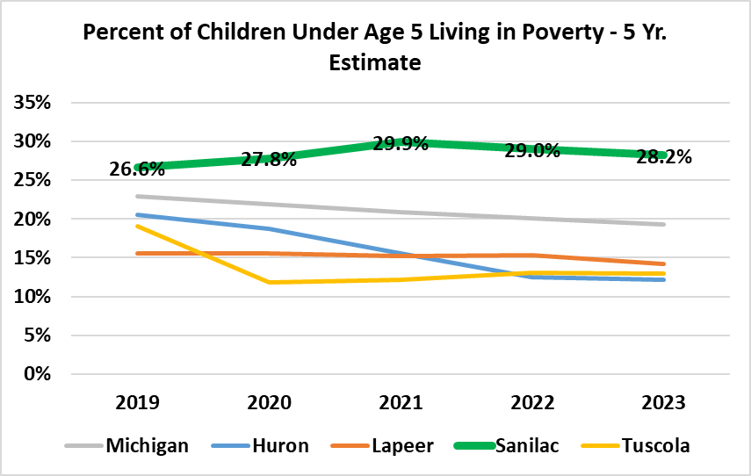
Percent of Children Under Age 5 in Living in Poverty(5 Year Estimate)
 | 2023
Michigan | 19.3%
Huron | 12.2%
Lapeer | 14.2%
Sanilac | 28.2%
Tuscola | 13.0%
U.S. Census 2023
https://data.census.gov/table

Slide 13
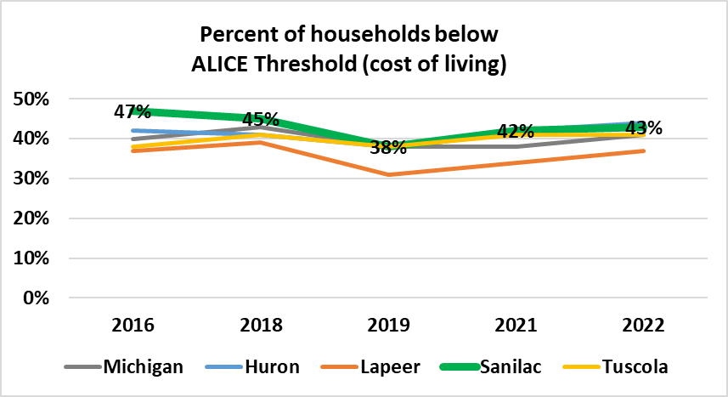
Percent of households below ALICE Threshold
 | 2022
Michigan | 41%
Huron | 44%
Lapeer | 37%
Sanilac | 43%
Tuscola | 41%
United Way- ALICE Report (Assets Limited Income Constrained Employed) 2024 Report https://unitedforalice.org/state-reports

Slide 14
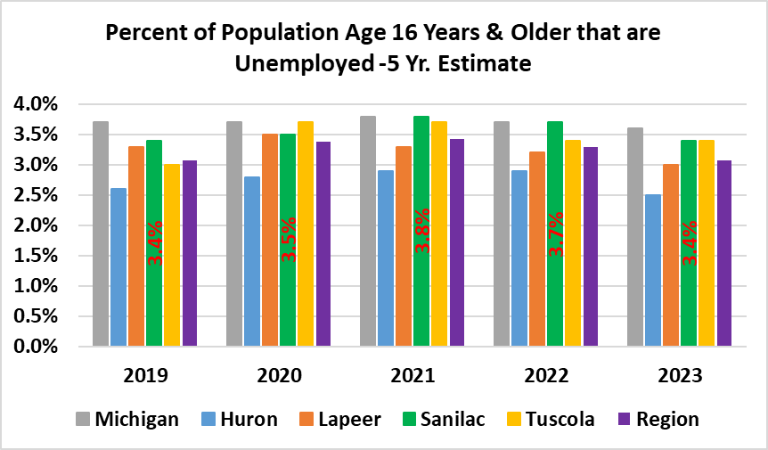
Percent of Population Age 16 Years & Older that are Unemployed -5 Yr. Estimate
 | 2023
Michigan | 3.6%
Huron | 2.5%
Lapeer | 3.0%
Sanilac | 3.4%
Tuscola | 3.4%
U.S. Census 2023
https://data.census.gov/table

Slide 15
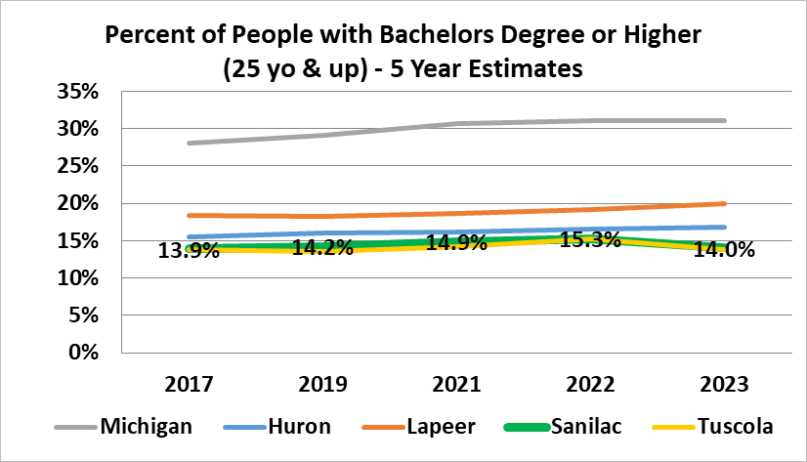
Percent of People with Bachelors Degree or Higher (25 yo & up) - 5 Year Estimates
 | 2023
Michigan | 31.0%
Huron | 16.8%
Lapeer | 20.0%
Sanilac | 14.0%
Tuscola | 13.8%
U.S. Census 2023
https://data.census.gov/table

Slide 16
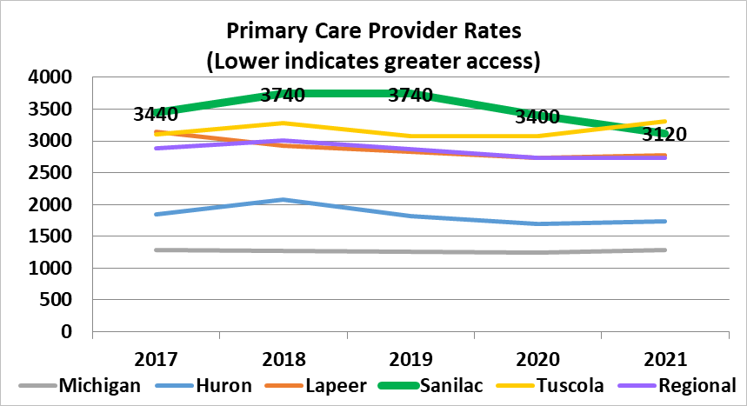
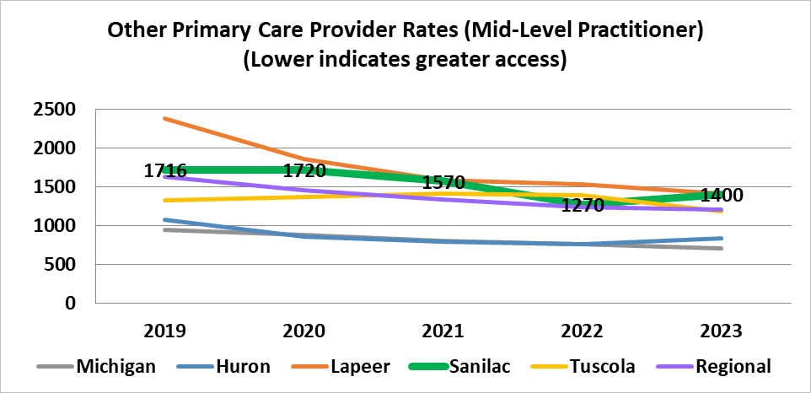
Access to Healthcare
Primary Care Provider Rates
 | 2021
Michigan | 1280
Huron | 1740
Lapeer | 2770
Sanilac | 3120
Tuscola | 3310
Mid-Level Practitioner Rates
 | 2023
Michigan | 710
Huron | 840
Lapeer | 1410
Sanilac | 1400
Tuscola | 1180
County Health Rankings 2024 (2021 was last data used for Primary Care Provider Rates)
www.countyhealthrankings.org

Slide 17
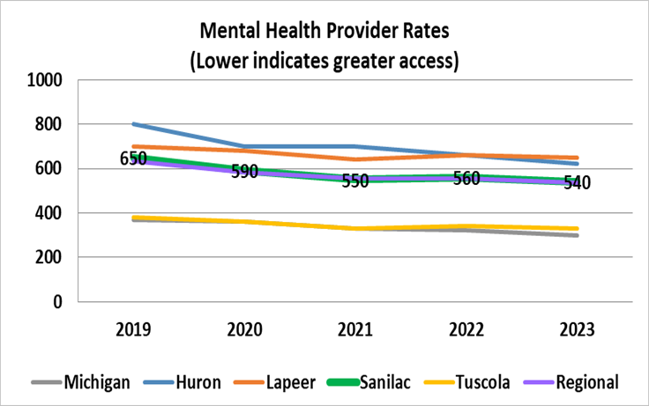
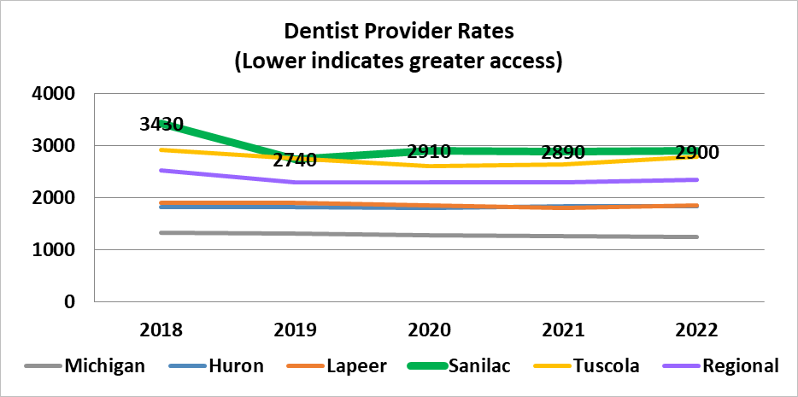
Mental Health Provider Rates
 | 2023
Michigan | 300
Huron | 620
Lapeer | 650
Sanilac | 540
Tuscola | 330
Dentist Provider Rates
 | 2022
Michigan | 1250
Huron | 1840
Lapeer | 1850
Sanilac | 2900
Tuscola | 2790
County Health Rankings 2024 (2021 was last data used for Primary Care Provider Rates)
www.countyhealthrankings.org

Slide 18
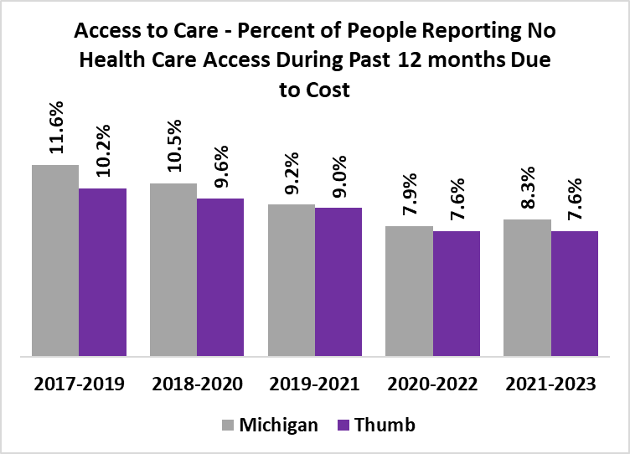
Data for Access to Care – Percent of People Reporting No Personal Healthcare Provider has been suppressed for all 4 counties 2021-2023 due to a denominator < 50 and/or a relative standard error > 30%. The Thumb region as a whole, is at 11.0% for 2021-2023 which is less than Michigan’s 11.6%, and has been showing a declining percentage since 2017. The chart below uses data from the Thumb region as a whole.
Michigan Department of Health and Human Services -Data for Huron, Sanilac and Tuscola suppressed due to a denominator < 50 and/or a relative standard error > 30%.
http://www.michigan.gov/mdhhs/0,5885,7-339-71550_5104_5279_39424-134707--,00.html

Slide 19
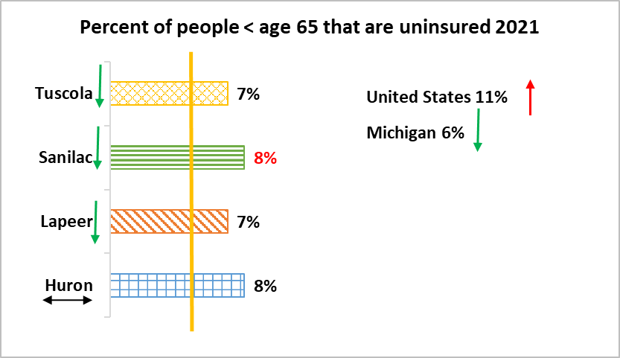
County Health Rankings 2024 Report
www.countyhealthrankings.org

Slide 20
Access to Care Highlights - Sanilac
Health Indicators
Community Survey
23% reported needing a specialist regularly and that it is not offered by local hospital.
46% report cost as a barrier to care
Access Rates | HC
Primary Care | Better
Other PCP Providers | Worse
Mental Health | Better
Dental | Worse
7.6% of Thumb residents report No Health Care Access due to cost 2021-2023
8% of people <65 uninsured 2021-2023

Slide 21
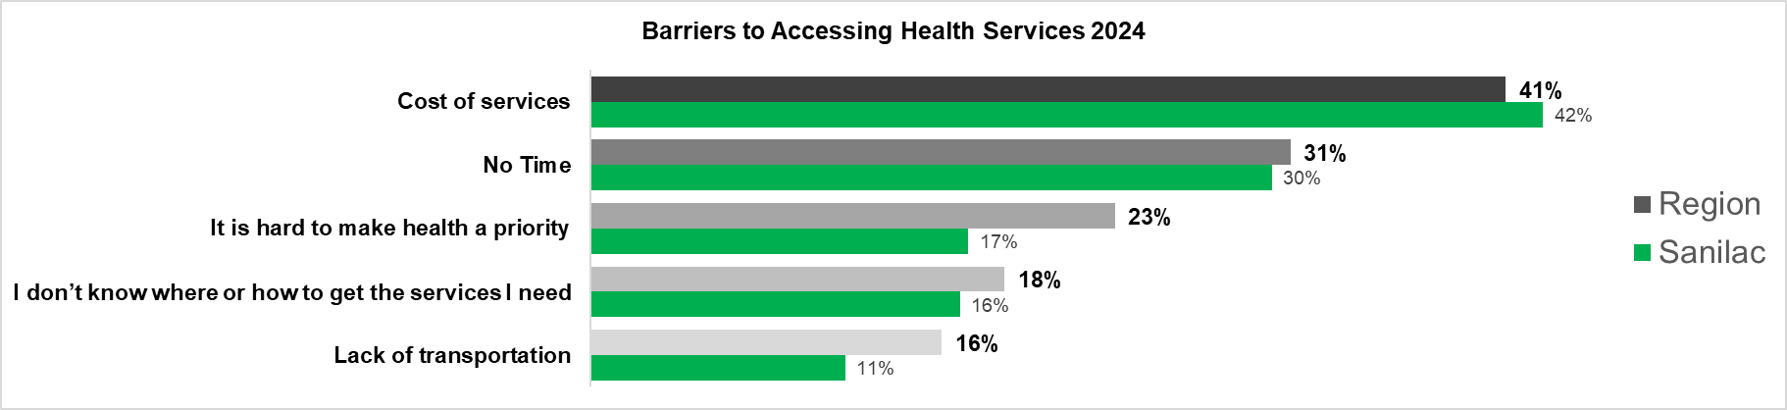
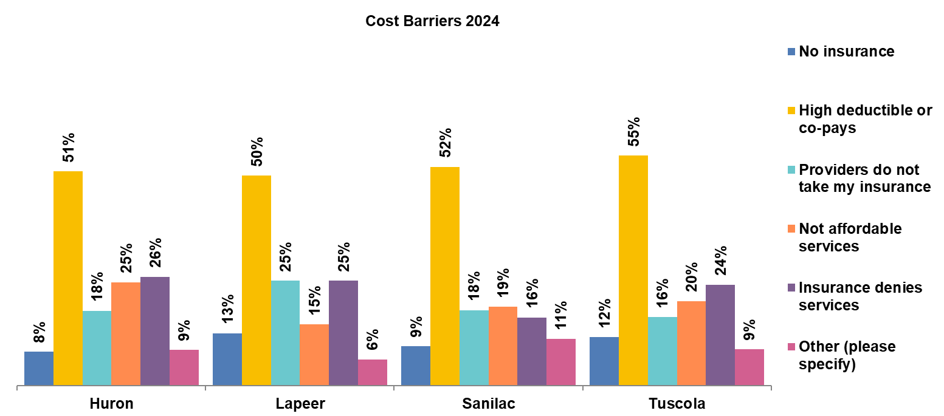
Community Survey- Health Concerns

Slide 22
Michigan Department of Health and Human Services
https://vitalstats.michigan.gov/osr/CHI/Deaths/frame.html

Slide 23
Chronic Disease
Health Outcomes
Heart Disease
Stroke
Diabetes
Cancer
Contributing Factors
Weight Status
Tobacco Use

Slide 24
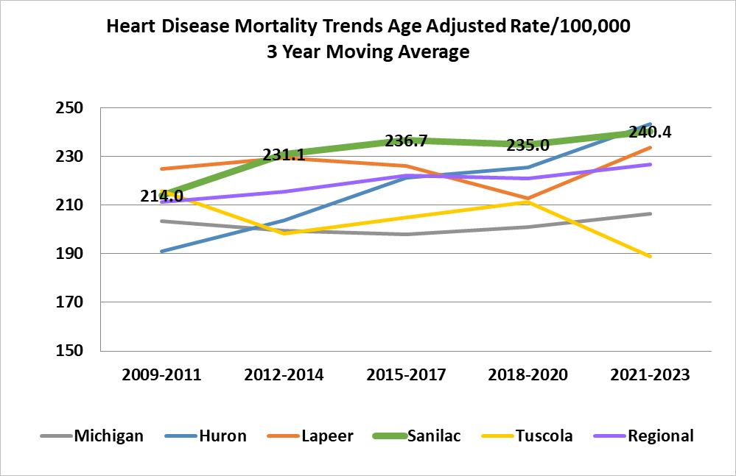
Heart Disease Mortality Trends Age Adjusted
 | 2021-2023
Michigan | 206.4
Huron | 243.5
Lapeer | 233.6
Sanilac | 240.4
Tuscola | 188.9
Michigan Department of Health and Human Services
https://vitalstats.michigan.gov/osr/chi/cri/frame.html

Slide 25
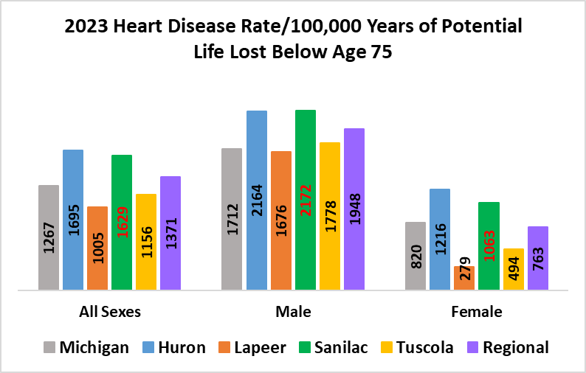
Michigan Department of Health and Human Services
https://vitalstats.michigan.gov/osr/chi/cri/frame.html

Slide 26
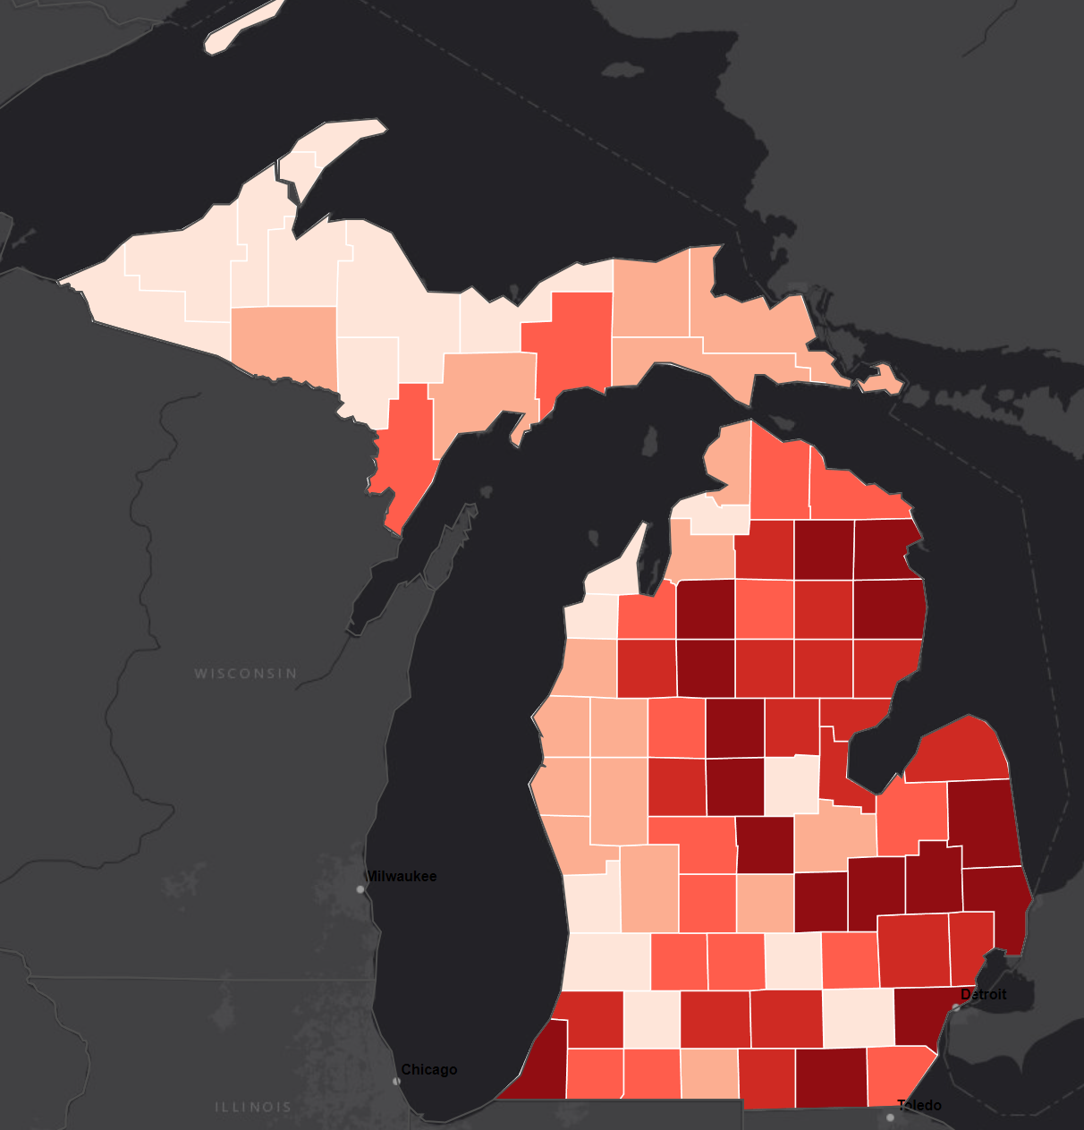
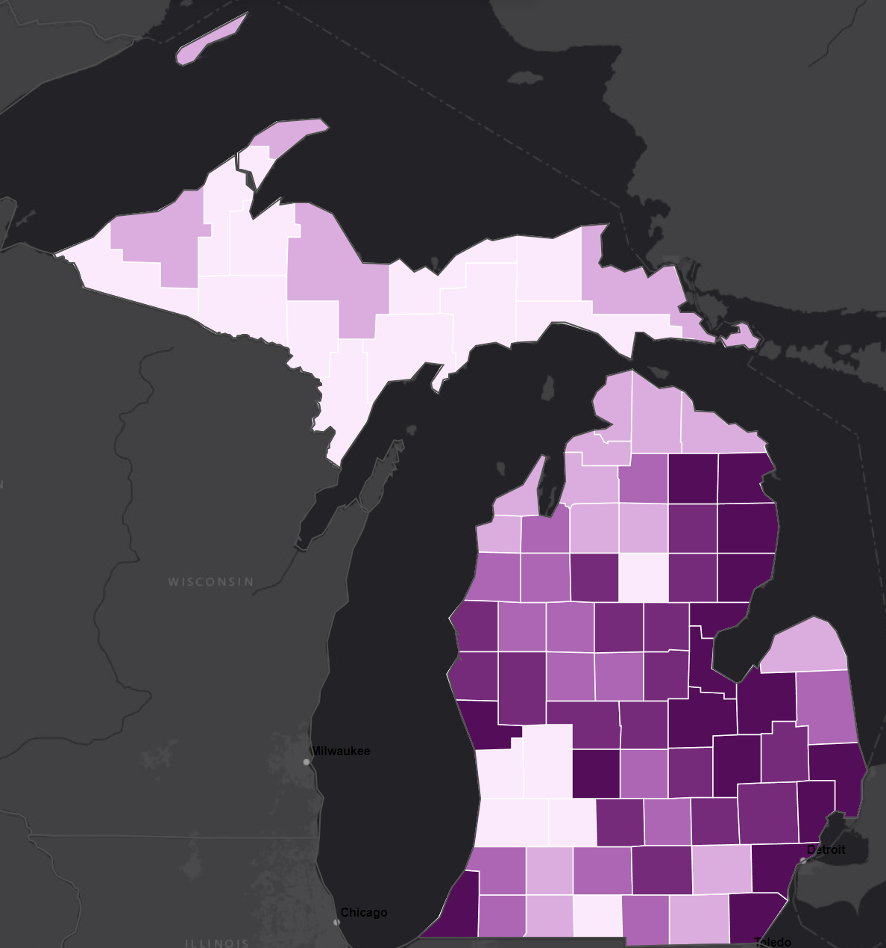
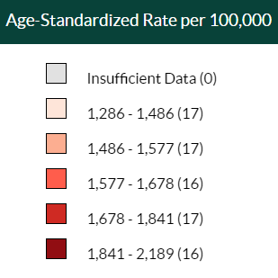
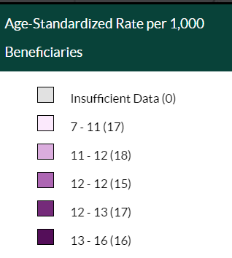
Total Cardiovascular Disease Death Rate per 100,000, 65+, All Races/Ethnicities, Both Genders, 2019-2021
Stroke Death Rate per 100,000, 65+, All Races/Ethnicities, Both Genders, 2019-2021
Center for Disease Control; Interactive Atlas
https://nccd.cdc.gov/DHDSPAtlas/Default.aspx

Slide 27
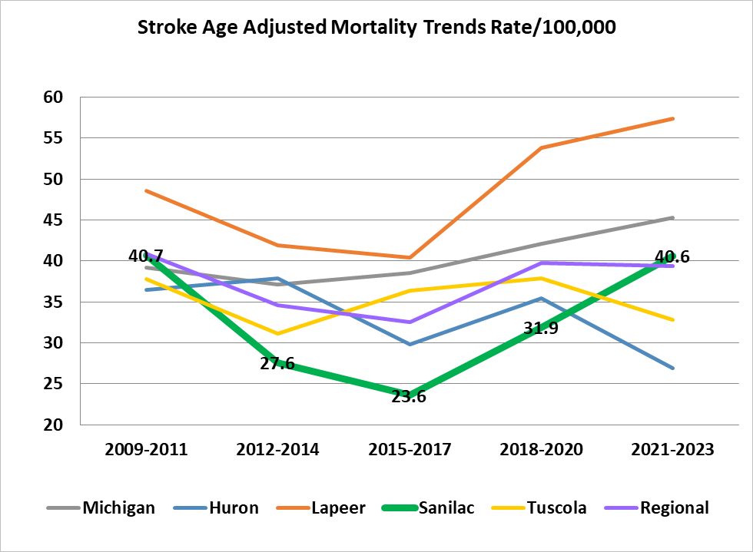
Stroke Age Adjusted Mortality Trends Rate/100,000
 | 2021-2023
Michigan | 45.3
Huron | 26.9
Lapeer | 57.4
Sanilac | 40.6
Tuscola | 32.8
Michigan Department of Health and Human Services
https://vitalstats.michigan.gov/osr/chi/cri/frame.html

Slide 28
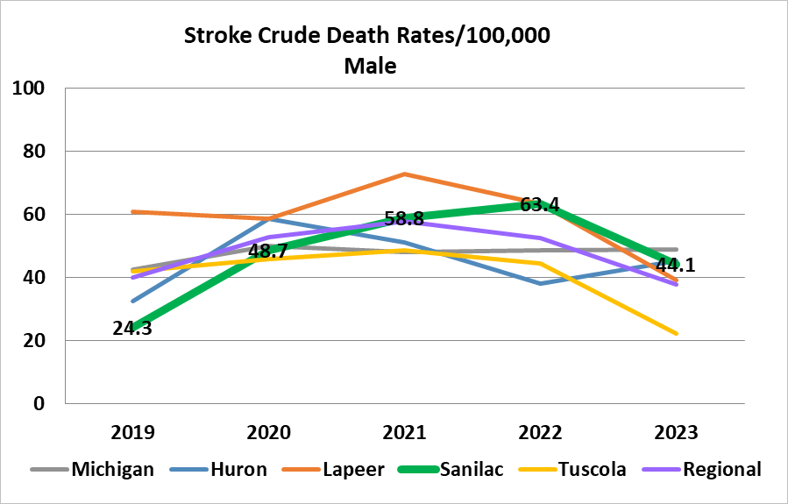
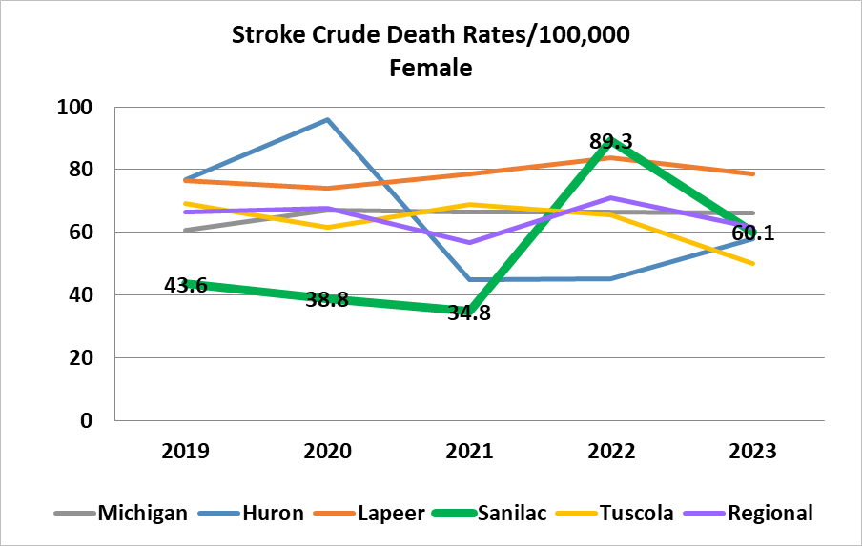
Michigan Department of Health and Human Services
https://vitalstats.michigan.gov/osr/CHI/Deaths/frame.html

Slide 29
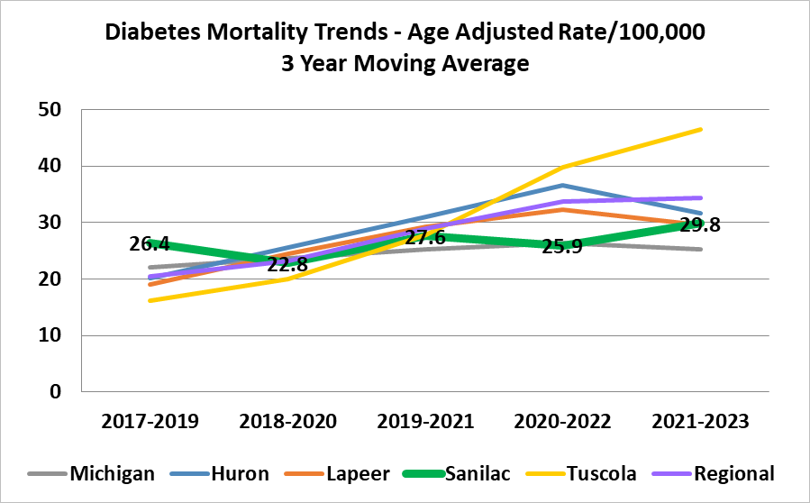
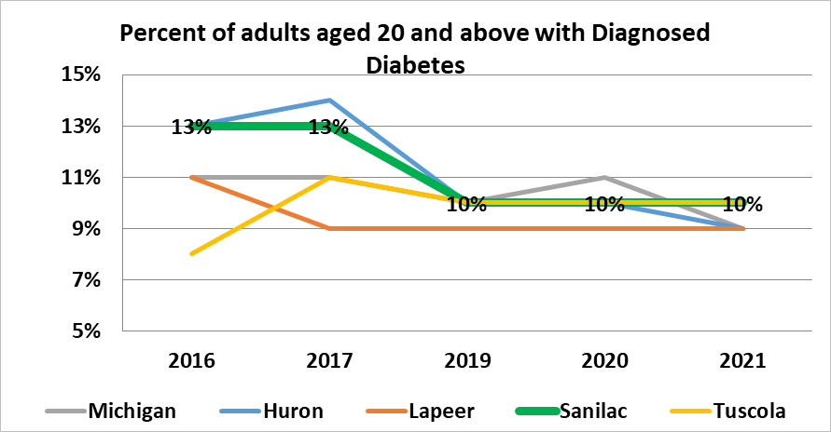
Diabetes Mortality Trend – Age Adjusted Rate
 | 2021-2023
Michigan | 25.3
Huron | 31.6
Lapeer | 29.5
Sanilac | 29.8
Tuscola | 46.4
Michigan Department of Health and Human Services
https://vitalstats.michigan.gov/osr/chi/cri/frame.html
% of Adults aged 20+ with Diagnosed Diabetes
 | 2021
Michigan | 9%
Huron | 9%
Lapeer | 9%
Sanilac | 10%
Tuscola | 10%
CDC Diabetes Interactive Atlas
www.countyhealthrankings.org

Slide 30
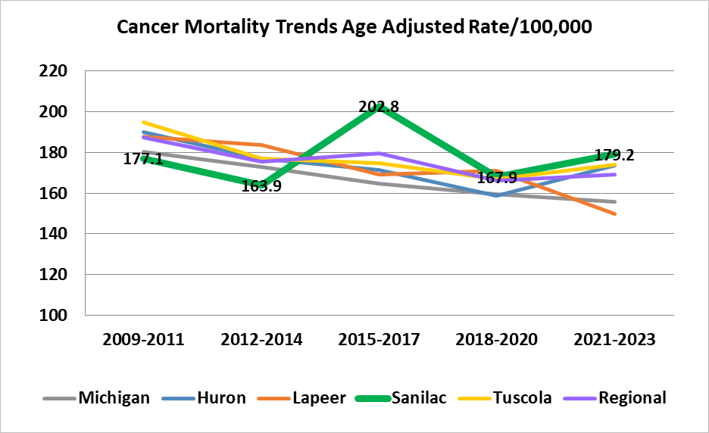
Cancer Mortality Trends Age Adjusted Rate
 | 2021-2023
Michigan | 155.9
Huron | 173.7
Lapeer | 149.9
Sanilac | 179.2
Tuscola | 173.9
Michigan Department of Health and Human Services
https://vitalstats.michigan.gov/osr/chi/IndexVer2.asp#Counties

Slide 31
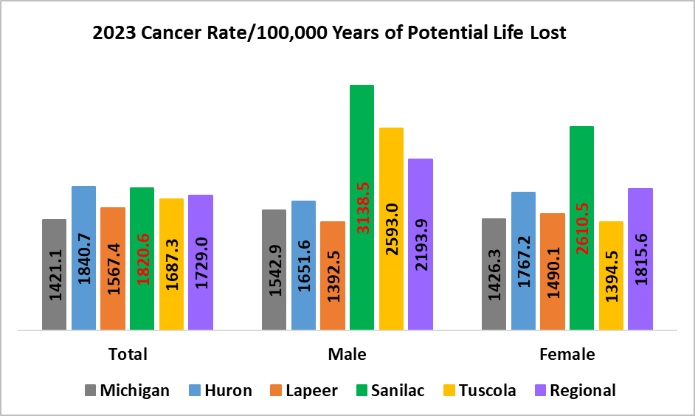
Michigan Department of Health and Human Services
https://vitalstats.michigan.gov/osr/chi/cri/frame.html

Slide 32
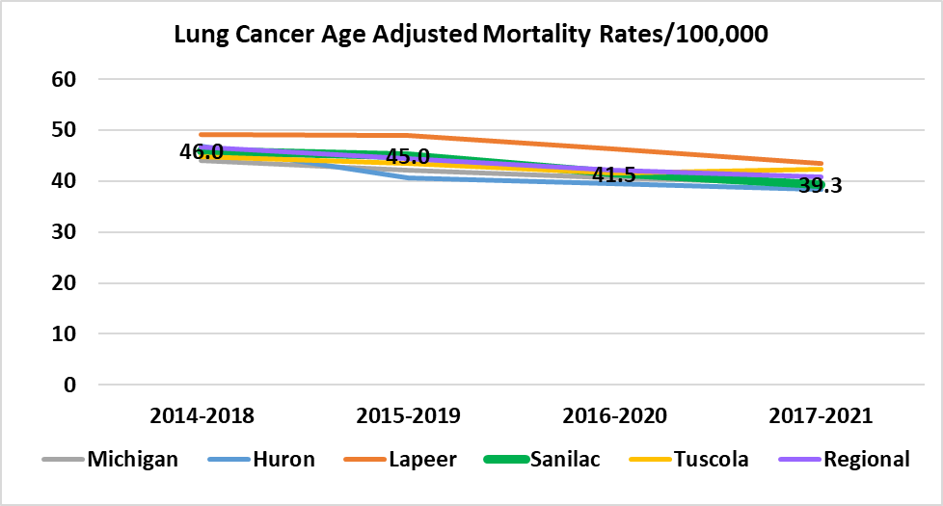
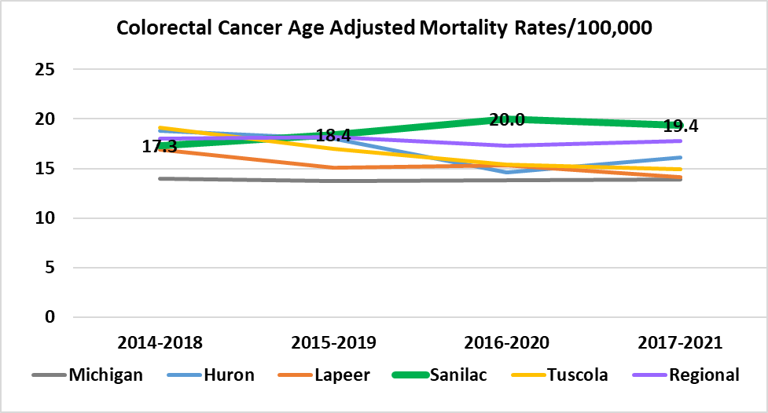
Lung Cancer Age Adjusted Mortality Rate
 | 2017-2021
Michigan | 39.5
Huron | 38.3
Lapeer | 43.4
Sanilac | 39.3
Tuscola | 42.4
Colorectal Cancer Age Adjusted Mortality Rates
 | 2017-2021
Michigan | 13.9
Huron | 16.1
Lapeer | 14.1
Sanilac | 19.4
Tuscola | 14.9
Michigan Department of Health and Human Services (No update by MDHHS on Cancer Incidence Mortality Rates since April 2023 which was based on 2021 data)
https://vitalstats.michigan.gov/osr/chi/cri/frame.html

Slide 33
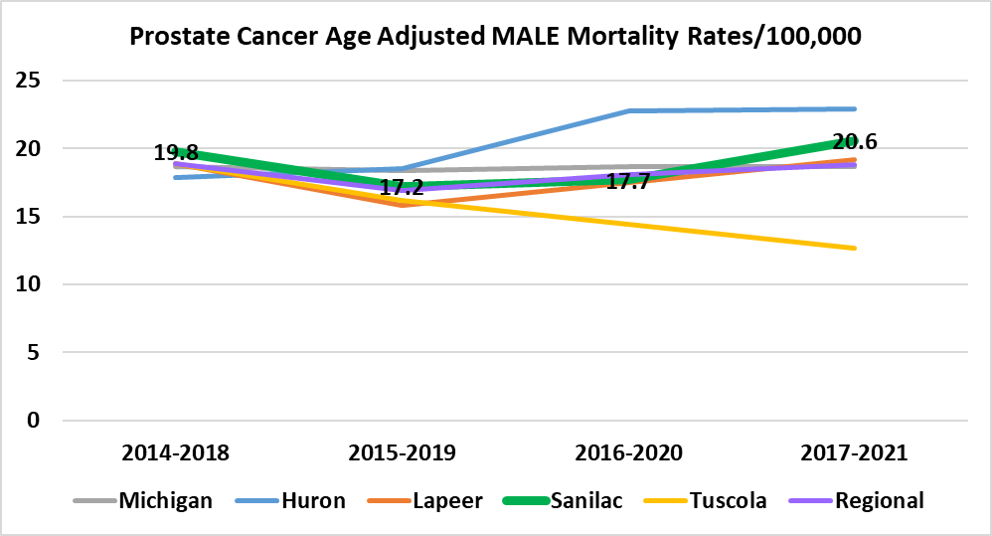
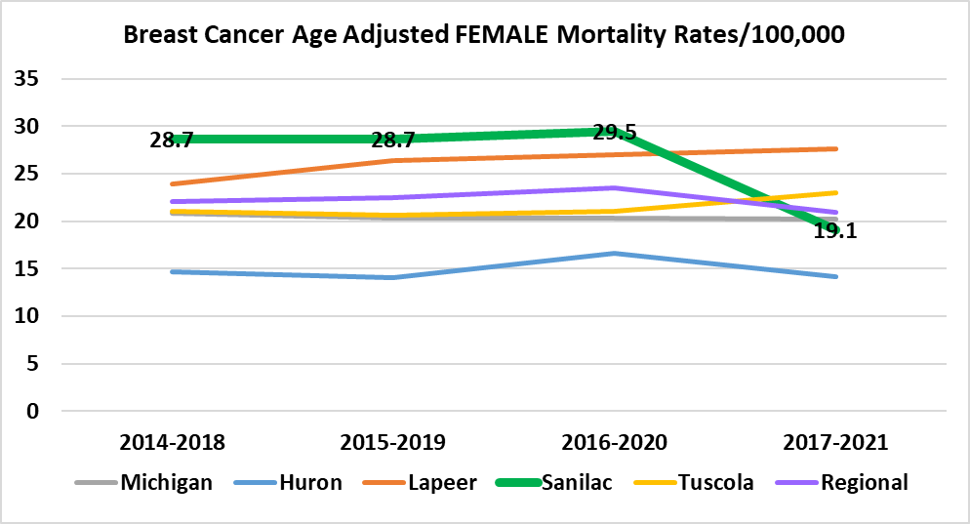
Prostate Cancer Age Adjusted Mortality Rate
 | 2017-2021
Michigan | 18.7
Huron | 22.9
Lapeer | 19.2
Sanilac | 20.6
Tuscola | 12.7
Breast Cancer Age Adjusted Mortality Rate
 | 2017-2021
Michigan | 20.2
Huron | 14.2
Lapeer | 27.6
Sanilac | 19.1
Tuscola | 23.0
Michigan Department of Health and Human Services (No update by MDHHS on Cancer Incidence Mortality Rates since April 2023 which was based on 2021 data)
https://vitalstats.michigan.gov/osr/chi/cri/frame.html

Slide 34
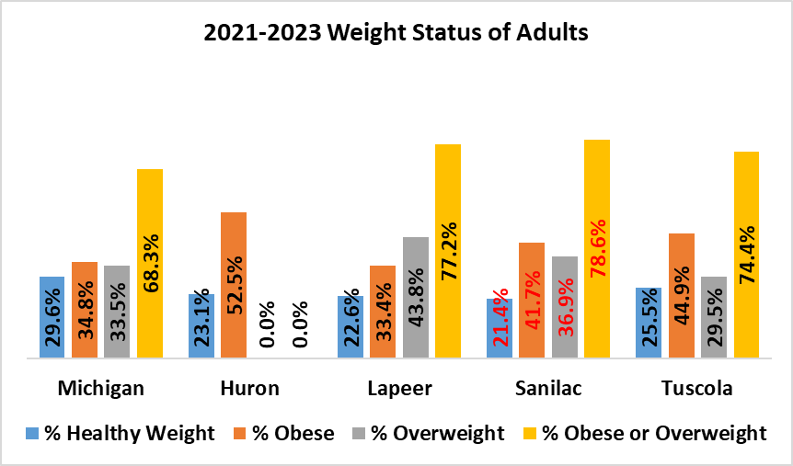
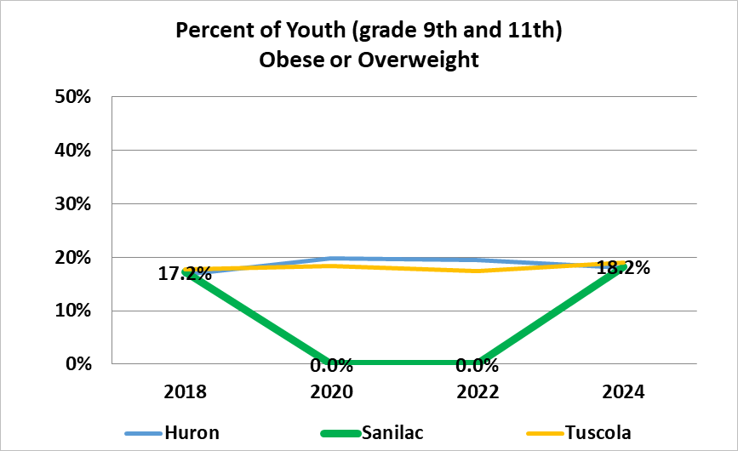
Michigan Department of Health and Human Services - BRFSS
http://www.michigan.gov/mdhhs/0,5885,7-339-71550_5104_5279_39424-134707--,00.html
Percent of Youth (grade 9th & 11th) Obese or Overweight
 | 2024
Huron | 18%
Lapeer | No Data
Sanilac | 18.2%
Tuscola | 19.0%
Michigan Profile for Healthy Youth (Data not available for Sanilac in SY2020 & 2022
https://mdoe.state.mi.us/schoolhealthsurveys/ExternalReports/CountyReportGeneration.aspx

Slide 35
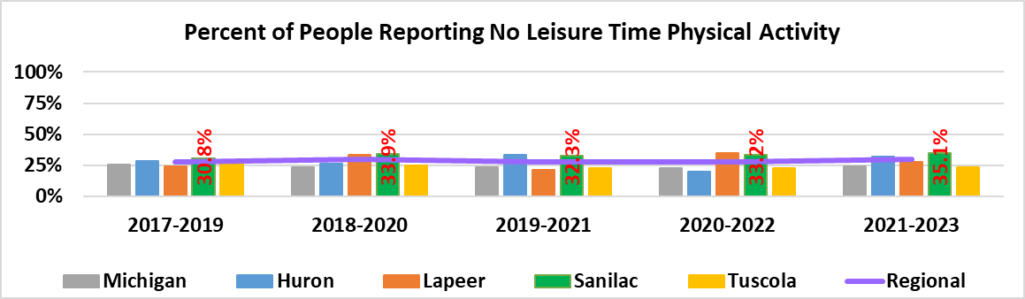
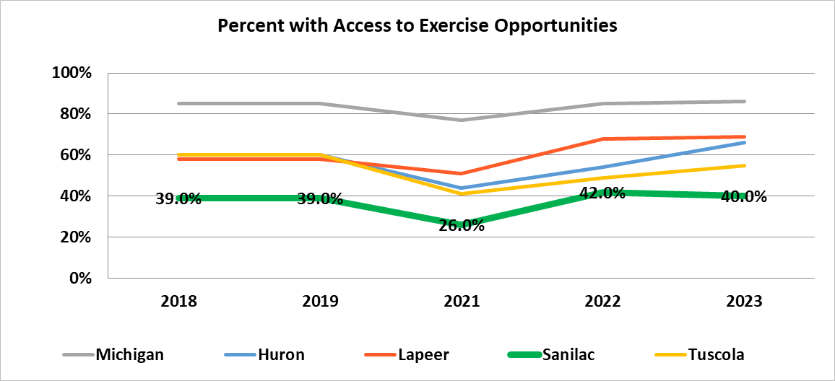
% of People Reporting No Leisure Time Physical Activity
 | 2021-2023
Michigan | 24.1%
Huron | 31.9%
Lapeer | 27.5%
Sanilac | 35.1%
Tuscola | 23.6%
Michigan Department of Health and Human Services – BRFSS
http://www.michigan.gov/mdhhs/0,5885,7-339-71550_5104_5279_39424-134707--,00.html
Percent with Access to Exercise Opportunities
 | 2023
Michigan | 86%
Huron | 66%
Lapeer | 69%
Sanilac | 40%
Tuscola | 55%
www.countyhealthrankings.org
County Health Rankings – University of Wisconsin Population Health Institute 2024

Slide 36
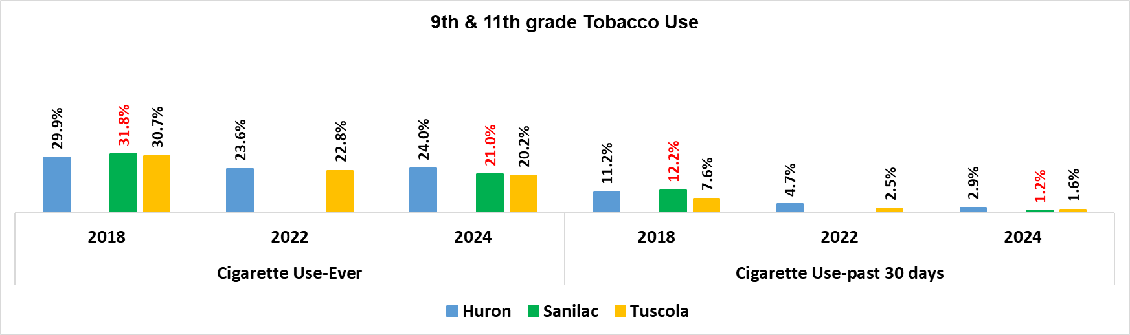
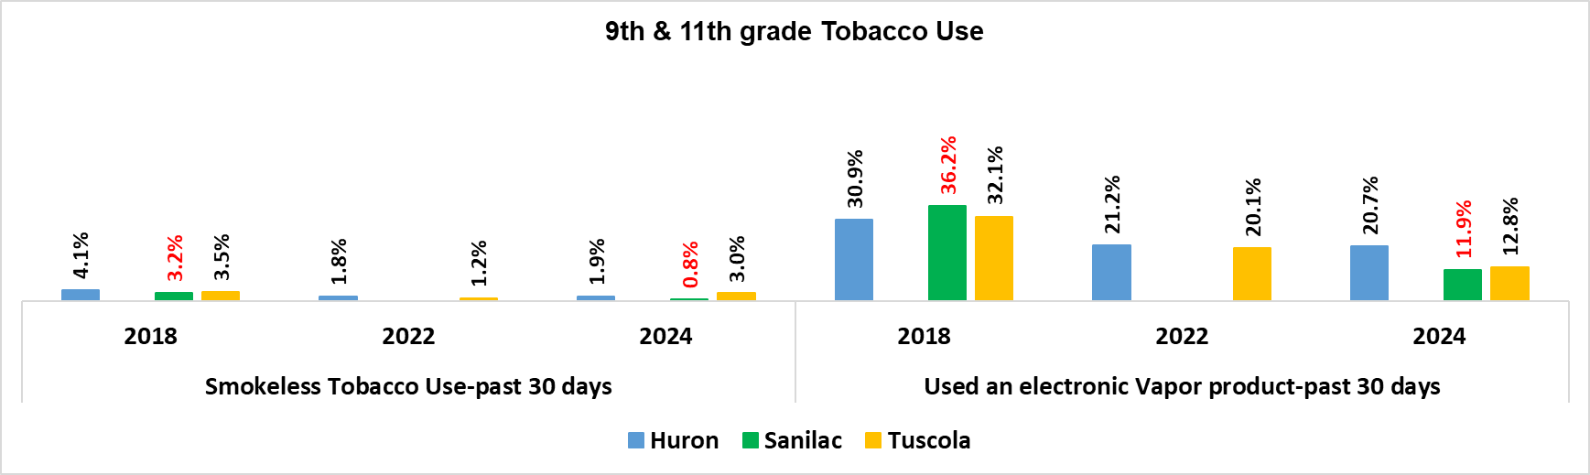
Michigan Profile for Health Youth
https://mdoe.state.mi.us/schoolhealthsurveys/ExternalReports/CountyReportGeneration.aspx Data not available for Michigan, Lapeer. No data available for Sanilac for 2014, 2016 and 2022.
Due to COVID 19 and school closures some schools administered the survey in 2020 and some in 2021. Results are being combined.

Slide 37
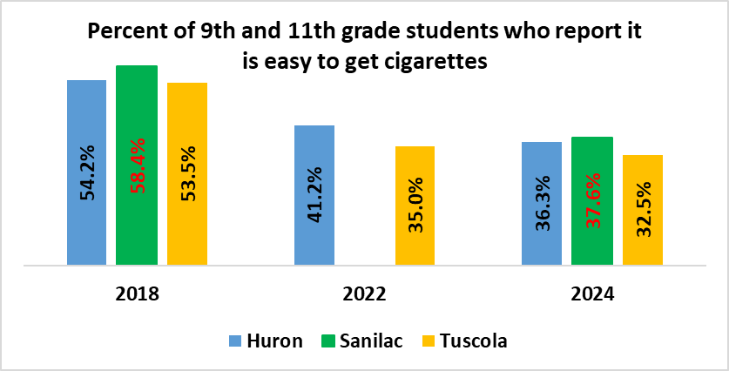
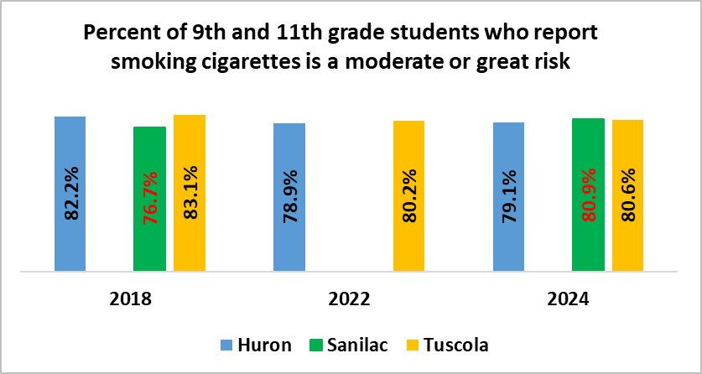
Michigan Profile for Health Youth
https://mdoe.state.mi.us/schoolhealthsurveys/ExternalReports/CountyReportGeneration.aspx Data not available for Michigan, Lapeer. No data available for Sanilac for 2014, 2016 and 2022.
Due to COVID 19 and school closures some schools administered the survey in 2020 and some in 2021. Results are being combined.

Slide 38
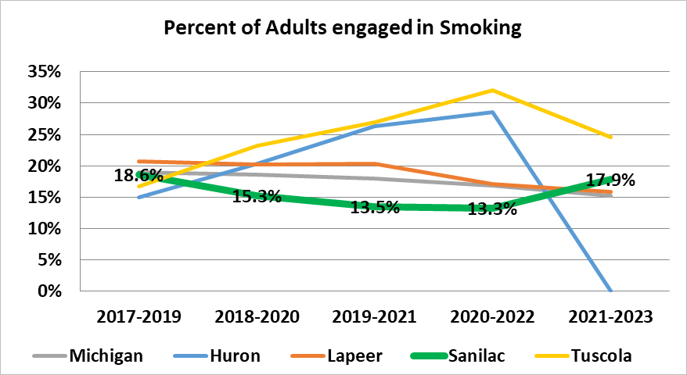
% of Adults engaged in Smoking
 | 2021-2023
Michigan | 15.3%
Huron | *
Lapeer | 15.9%
Sanilac | 17.9%
Tuscola | 24.6%
Michigan Department of Health and Human Services (Data suppressed for Huron due to denominator <50 and/or relative standard error >30% in 2021-2023)
http://www.michigan.gov/mdhhs/0,5885,7-339-71550_5104_5279_39424-134707--,00.html

Slide 39
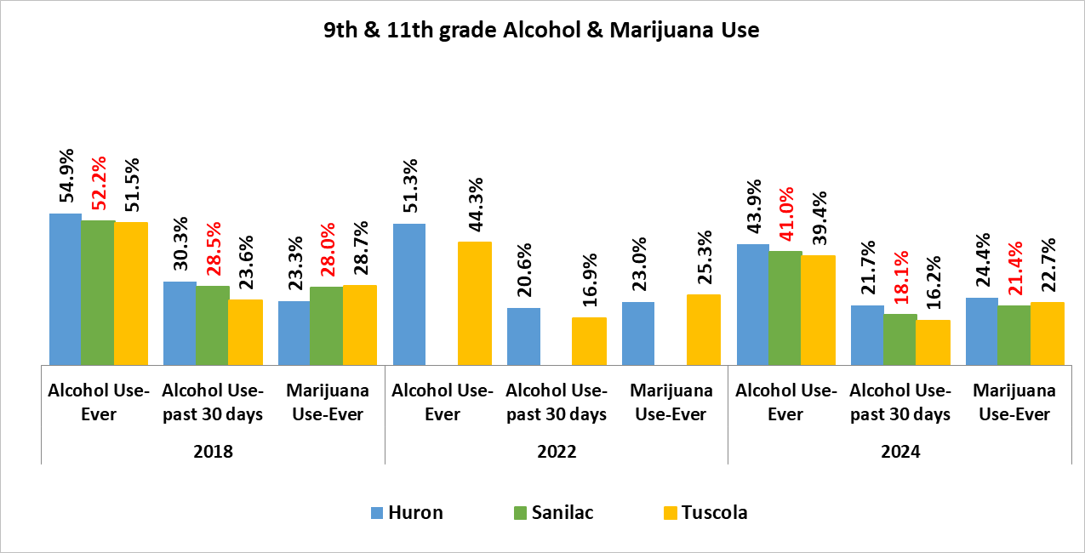
Behavioral Health
Substance Use
Michigan Profile for Health Youth
https://mdoe.state.mi.us/schoolhealthsurveys/ExternalReports/CountyReportGeneration.aspx Data not available for Michigan, Lapeer. No data available for Sanilac for 2014, 2016 and 2022.
Due to COVID 19 and school closures some schools administered the survey in 2020 and some in 2021. Results are being combined.

Slide 40
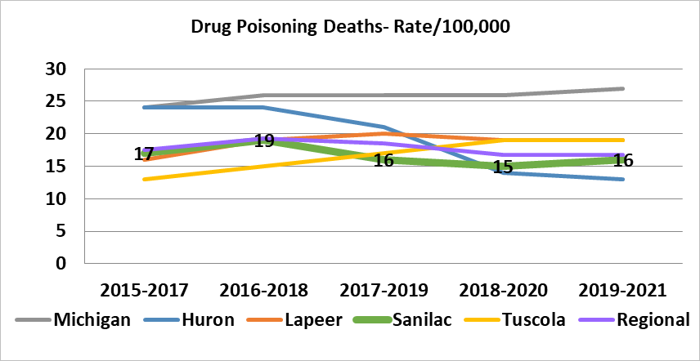
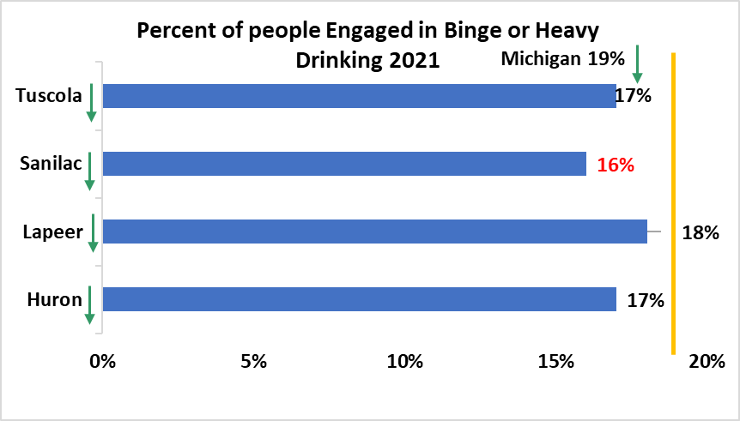
Drug Poisoning Deaths - Rate
 | 2019-2021
Michigan | 27
Huron | 13
Lapeer | 19
Sanilac | 16
Tuscola | 19
County Health Rankings 2024
www.countyhealthrankings.org
County Health Rankings 2024
www.countyhealthrankings.org

Slide 41
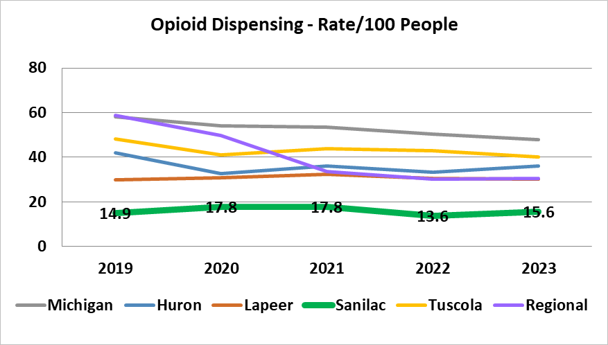
Opioid Dispensing Rate
 | 2023
Michigan | 47.9
Huron | 36.0
Lapeer | 30.0
Sanilac | 15.6
Tuscola | 40.2
Center for Disease Control
https://www.cdc.gov/drugoverdose/maps/rxrate-maps.html

Slide 42
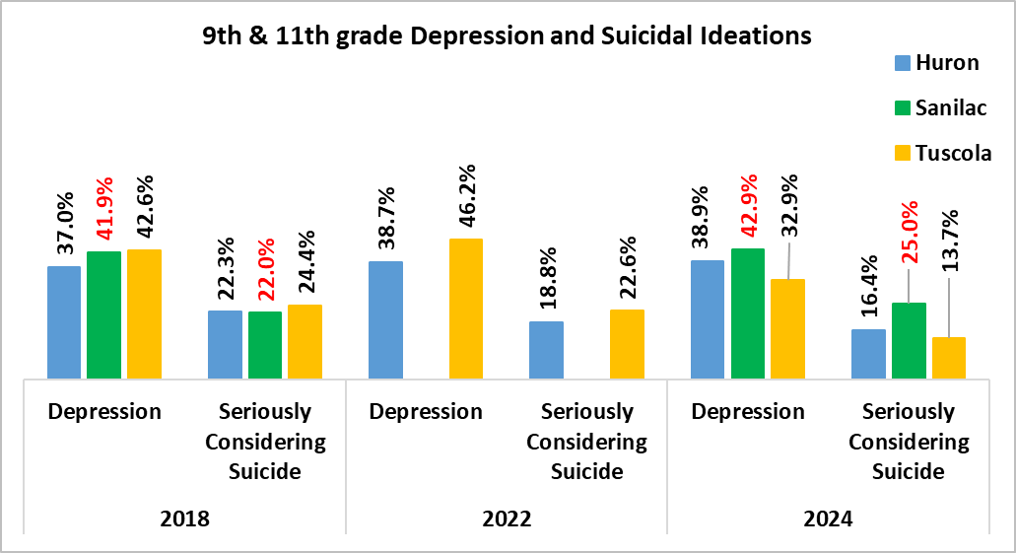
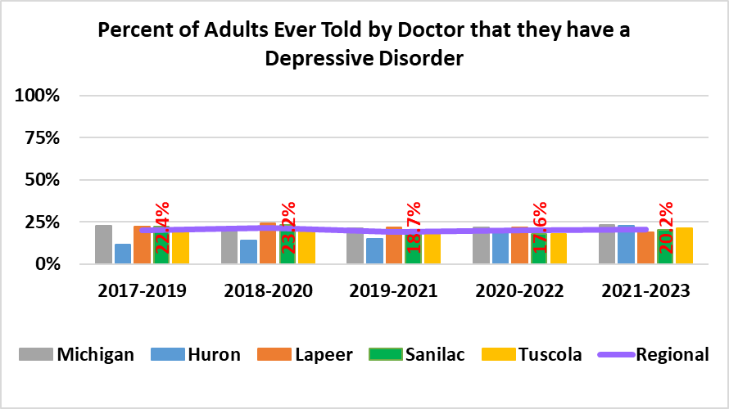
Mental Health
Data not available for Michigan, Lapeer, and Sanilac (2014, 2016, 2022).
Percentage of students who seriously considered attempting suicide during the past 12 months
% of 9th & 11th grade students who felt so sad or hopeless almost every day for two weeks or more in a row that they stopped doing some usual activities during the past 12 months
Michigan Profile for Healthy Youth
https://mdoe.state.mi.us/schoolhealthsurveys/ExternalReports/CountyReportGeneration.aspx
Due to COVID 19 and school closures some schools administered the survey in 2020 and some in 2021. Results are being combined.
% of Adults ever told by Doctor they have a Depressive Disorder
 | 2021-2023
Michigan | 23.2%
Huron | 22.6%
Lapeer | 19.0%
Sanilac | 20.2%
Tuscola | 21.1%
Michigan Department of Health and Human Services
http://www.michigan.gov/mdhhs/0,5885,7-339-71550_5104_5279_39424-134707--,00.html

Slide 43
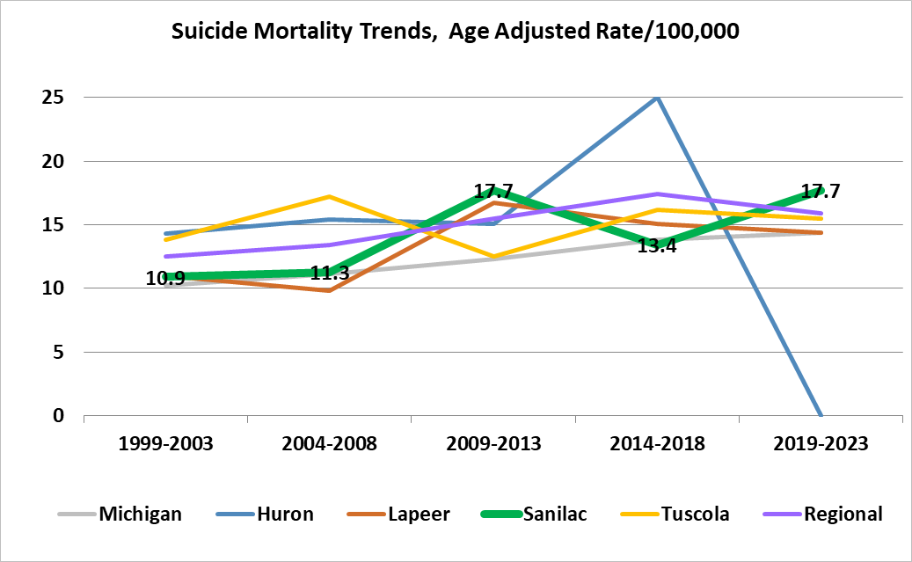
Over the past 10 years,
83%
of suicide deaths in Sanilac County were men
Suicide Mortality Trends Age Adjusted Rate
 | 2019-2023
Michigan | 14.4
Huron | *
Lapeer | 14.4
Sanilac | 17.7
Tuscola | 15.5
Michigan Department of Health and Human Services *Data suppressed due to a denominator < 50 and/or a relative standard error >30% for Huron 2021-2023
https://vitalstats.michigan.gov/osr/CHI/CRI/frame.asp

Slide 44
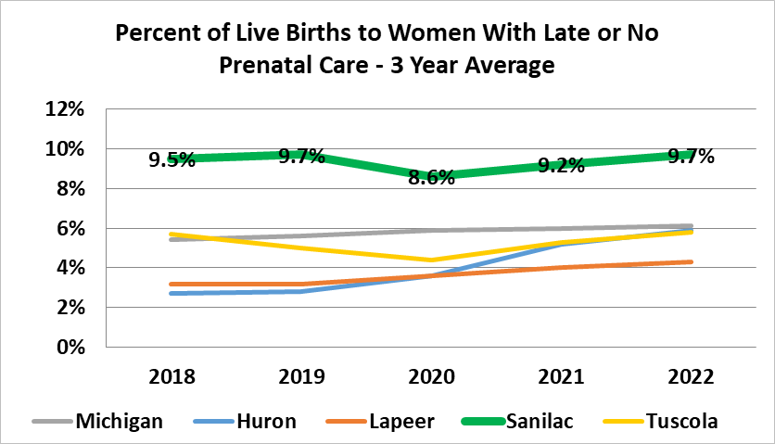
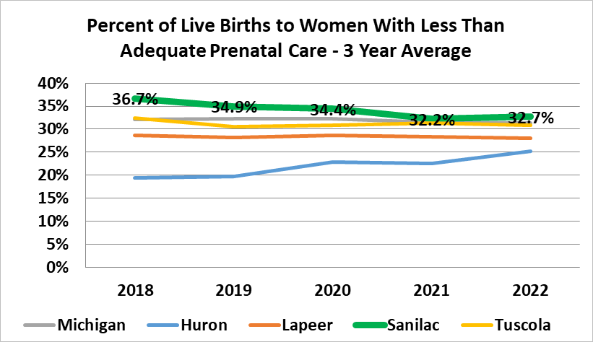
Maternal Child Health
% of Live Births to Women with Late or No Prenatal Care – 3 Yr Average
 | 2022
Michigan | 6.1%
Huron | 5.9%
Lapeer | 4.3%
Sanilac | 9.7%
Tuscola | 5.8%
% Live Births to Women with Less than Adequate Prenatal Care – 3 Yr Average
 | 2022
Michigan | 31.3%
Huron | 25.2%
Lapeer | 28.0%
Sanilac | 32.7%
Tuscola | 30.9%
Kids Count
https://datacenter.aecf.org/data/customreports/3775,3787,3819,3822/any

Slide 45


Infant Mortality Rate (age <1 year)
 | 2019-2023
Michigan | 6.4
Huron | *
Lapeer | 7.3
Sanilac | 5
Tuscola | 6.8
Michigan Department of Health and Human Services
https://vitalstats.michigan.gov/osr/chi/IndexVer2.asp#Counties
% Live Births to Women who Smoked during Pregnancy – 3 Yr Average
 | 2021-2023
Michigan | 8.5%
Huron | 16.4%
Lapeer | 10.9%
Sanilac | 15.2%
Tuscola | 16.7%
Michigan Department of Health and Human Services
https://vitalstats.michigan.gov/osr/chi/births14/frameBxChar.html

Slide 46


Michigan Resident Live Birth Files Linked with Michigan Hospital Discharge Data, Division for Vital Records and Statistics, Michigan Department of Health and Human Services
https://www.michigan.gov/mdhhs/-/media/Project/Websites/mdhhs/MCH-Epidemiology/202303-NAS-by-Prosperity-Region-20122021--Webpage.pdf?rev=a14a1d6e407346578788b8102100fd2c&hash=C14CA45C10FB6C65367F0DB182E60B0B

Slide 47

% of Births to Mothers < age 20
 | 2021-2023
Michigan | 3.6%
Huron | 2.8%
Lapeer | 2.7%
Sanilac | 3.6%
Tuscola | 3.8%
Michigan Department of Health and Human Services
https://vitalstats.michigan.gov/osr/chi/births14/frameBxChar.html

Slide 48

Immunizations
Michigan Department of Health and Human Services – BRFSS - Data for Huron and Sanilac suppressed due to a denominator < 50 and/or a relative standard error > 30%.
http://www.michigan.gov/mdhhs/0,5885,7-339-71550_5104_5279_39424-134707--,00.html

Slide 49

% Toddlers Ages 19-35 Months who are Fully Immunized
 | 2023
Michigan | 69.8%
Huron | 77.2%
Lapeer | 61.1%
Sanilac | 66.0%
Tuscola | 67.5%
September 30, 2024
MDHHS Report Card for Sanilac (4313314 coverage) 57.2%
Kids Count
https://datacenter.aecf.org/data/customreports/3775,3787,3819,3822/any

Slide 50


Injuries
Injury & Poisoning Hospitalizations 5 Yr. Annual Rate
 | 2017-2022
Michigan | 95.7
Huron | 116.8
Lapeer | 102.7
Sanilac | 100.5
Tuscola | 121.3
Michigan Department of Health and Human Services
https://vitalstats.michigan.gov/osr/chi/FATAL2/frame.asp
% of Motor Vehicle Accident Deaths where Alcohol was Involved
 | 2017-2021
Michigan | 30%
Huron | 26%
Lapeer | 27%
Sanilac | 33%
Tuscola | 44%
County Health Rankings
www.countyhealthrankings.org

Slide 51


Fatal Injuries – 5 Yr Age Adjusted Rates
 | 2019-2023
Michigan | 85.1
Huron | 72.8
Lapeer | 77.4
Sanilac | 82
Tuscola | 79.5
Michigan Department of Health and Human Services
https://vitalstats.michigan.gov/osr/chi/FATAL2/frame.asp

Slide 52


Rate Children Ages 0-8 who are Confirmed Victims of Child Abuse/Neglect
 | 2023
Michigan | 14.3
Huron | 20.4
Lapeer | 9.7
Sanilac | 19.8
Tuscola | 13.0
Kids Count
https://datacenter.aecf.org/data/customreports/3775,3787,3819,3822/any
Rate Children Ages 0-8 who lived in Families Investigated for Child Abuse or Neglect
 | 2023
Michigan | 103.5
Huron | 126.6
Lapeer | 82.8
Sanilac | 140.3
Tuscola | 127.5

Slide 53


Oral Health
Michigan Department of Health and Human Services – BRFSS Oral Health Data not collected in BRFSS in BRFSS 2019-2021. Data for Huron, Sanilac and Tuscola suppressed due to a denominator < 50 and/or a relative standard error > 30% for 2019 and 2020 Combined
http://www.michigan.gov/mdhhs/0,5885,7-339-71550_5104_5279_39424-134707--,00.html
Michigan Profile for Healthy Youth 2024 – No data available for Sanilac for 2022
https://mdoe.state.mi.us/schoolhealthsurveys/ExternalReports/CountyReportGeneration.aspx

Slide 54

Community Survey
  Conducted in October 2024
  690 people participated via paper and online in the Thumb Region.
  148 Sanilac residents participated in 2024.
  Zip code reports for service areas are available upon request for TCHP Partners.

Slide 55

Community Strengths and Weaknesses Sanilac County 2021 vs 2024

Slide 56

Community Survey- Community Concerns

Slide 57
The level and quality of health and human services in a community can help people live healthier or be a barrier to living healthy. In your opinion, how well does the healthcare and human service system work in our community? (1 Very Poor to 5 Very Good)
Sanilac County
3.2

Slide 58

Community’s view of how well the local Healthcare and Human Service System Works

Slide 59

Community Survey- Healthcare & Human Service System Strengths and Weakness 2021 vs 2024

Slide 60
Do you need a health service or specialist regularly (weekly, monthly) that is not currently offered by your local hospital?
(Yes, No)
Sanilac- 22.56%
Region- 20.22%

Slide 61

Community Survey- Strengths and Weaknesses of Service System and Providers
Top 3 Sources of Health Information in Sanilac County:
PCP (89%); Web Searches (40%); Other Healthcare Provider (37%)

Slide 62



Slide 63
Next Steps
Discussion of Data
Review existing priorities and implementation plan
Identification of priorities
Assess resources already addressing priorities
Community Feedback
Finalize implementation plan
Write reports
Reports and more information at www.thumbhealth.org or contact Kay Balcer, TCHP Director at balcer@thumbhealth.org

